Slide 1
SMART CAR-PARKING
SYSTEM USING IoT
201EI121 – LOCHANI V
201EI111 – GOBIKA D
201EI130 – SANJAI R
201EI115 - JAYAPRABHA P

Slide 2
ABSTRACT:
In recent times the concept of smart cities have gained grate popularity. Thanks to the evolution of Internet of things the idea of smart city now seems to be achievable. Consistent efforts are being made in the field of IoT in order to maximize the productivity and reliability of urban infrastructure. Problems such as, traffic congestion, limited car parking facilities and road safety are being addressed by IoT. In this paper, we present an IoT based cloud integrated smart parking system. The proposed Smart Parking system consists of an on-site deployment of an IoT module that is used to monitor and signalize the state of availability of each single parking space. A mobile application is also provided that allows an end user to check the availability of parking space and book a parking slot accordingly.

Slide 3
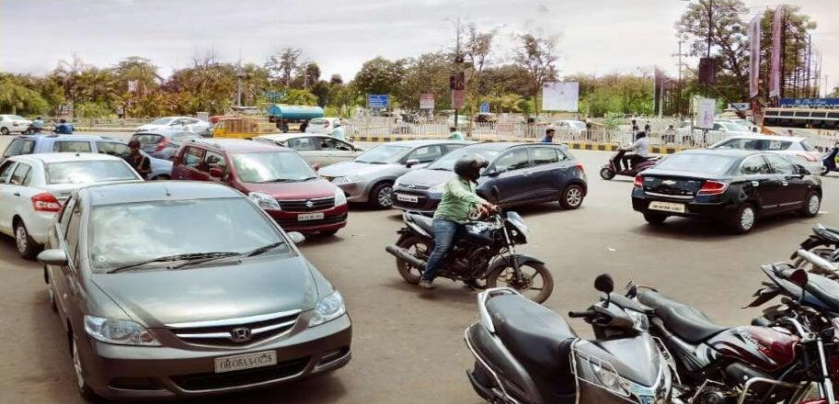
PROBLEM STATEMENT:
With increase in the population number of vehicles increases and due to unmanaged parking it leads to many problems.
All vehicles enter into the parking and waste time for searching for parking slot.

Slide 4
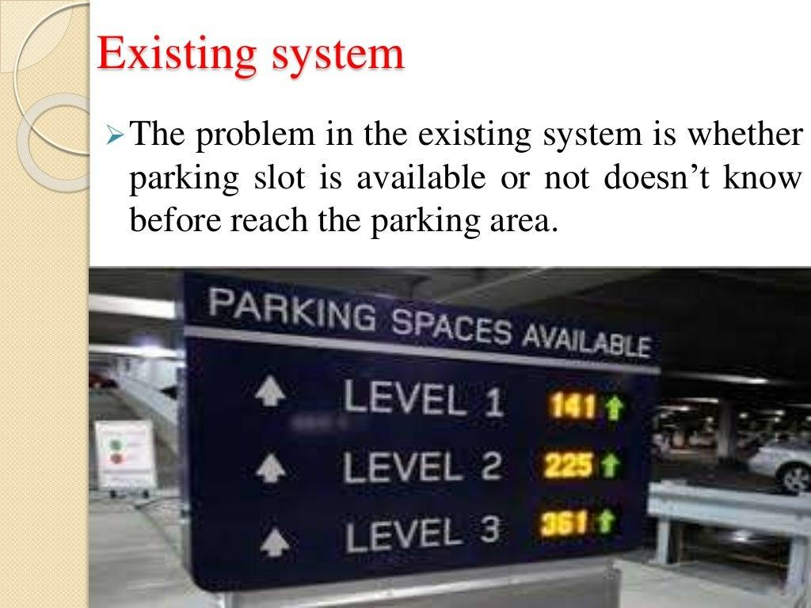
EXISTING SOLUTION:
Smart car parking system is an integrated system to organize cars in public areas.
The problem in the existing system is whether parking slot is available or not doesn’t know before reaching the parking area.
It eliminates the unnecessary travelling of vehicles across the filled parking slots in a city.

Slide 5
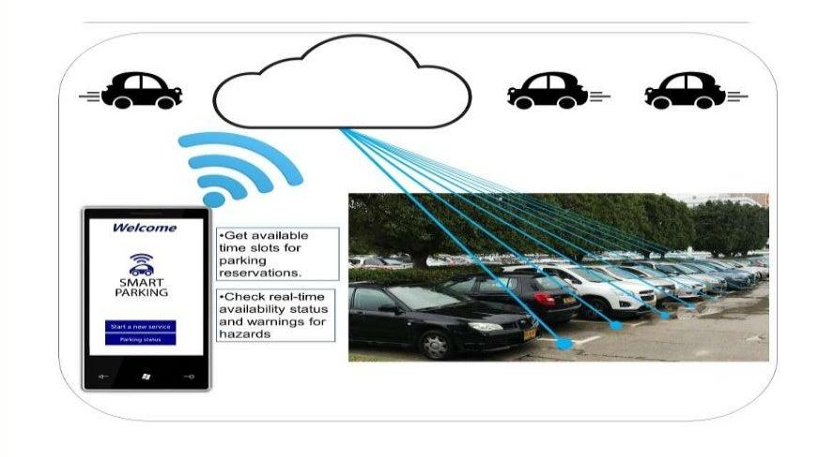
PROPOSED SOLUTION:
To find the parking space from anywhere by using mobile application.(like restaurant, theatre, etc.)

Slide 6
PROJECT PLAN:
Implementation of the proposed system.
To study software and hardware components.
Experimental setup of proposed design.
Checking the output by writing appropriate code.
Result and discussion.

Slide 7
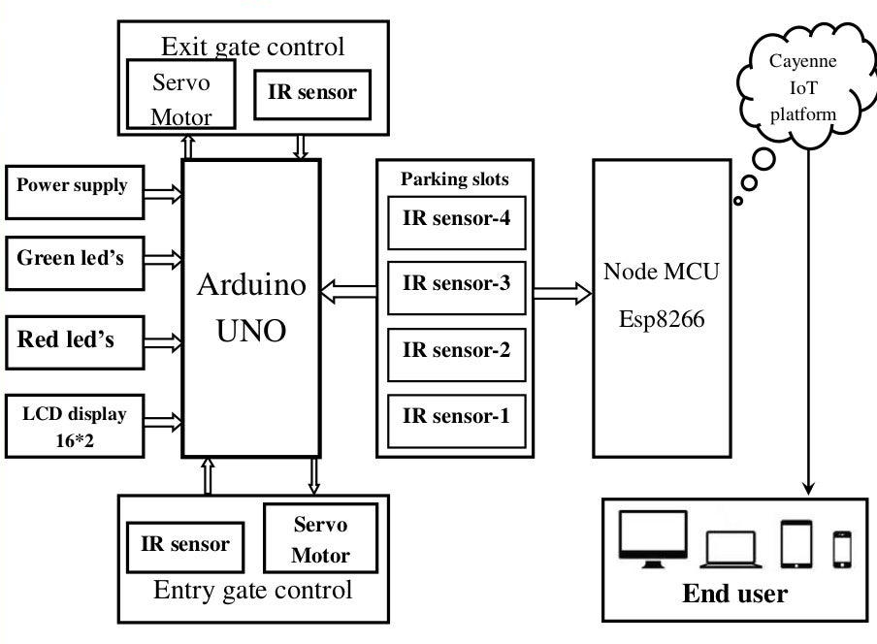
BLOCK DIAGRAM:

Slide 8
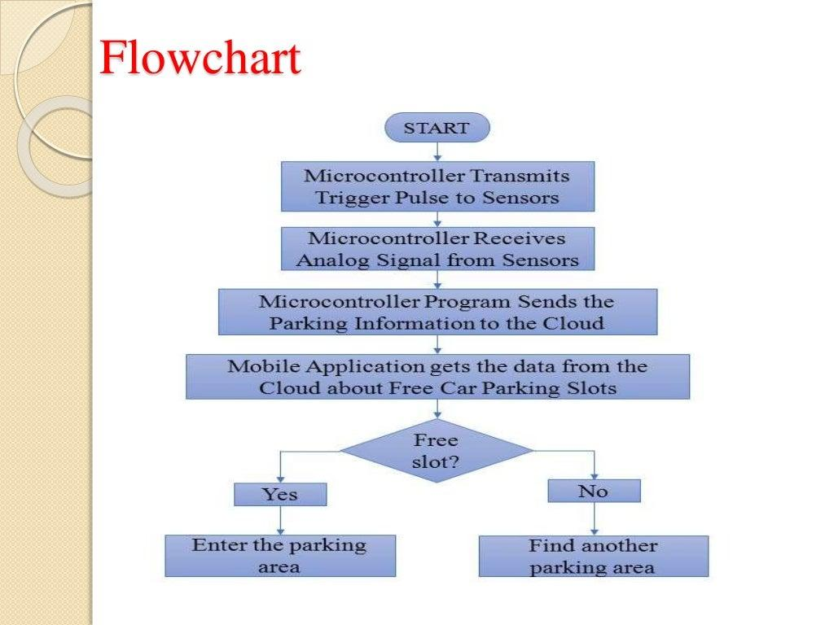
FLOW CHART:

Slide 9
MODERN TOOL AND CLOUD:
In this we are using components like Arduino, Node MCU, IR sensor, LCD display, Servo motor and LED.
For this project we are using Arduino IDE platform, because it supports the languages c and c++. It supplies a software library from the wiring project, which provides many common input and output procedures.

Slide 10
LIST OF COMPONENTS:
Hardware ;
Node MCU
ARDUINO UNO
IR Sensors
Servo Motors
LED lights
LCD Display
Software;
Arduino IDE
Cayenne

Slide 11
RESULT AND DISCUSSION:
This project focuses on implementation of car parking place detection using Internet of Things.
The system benefits of smart parking go well beyond avoiding time wasting.
Developing a smart parking solutions with in a city solves the pollution problem.

Slide 12
THANK YOU

